Slide 1
Curvas de Bézier

Slide 2
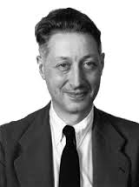
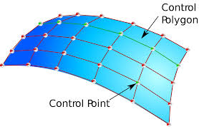
Introducción

Slide 3
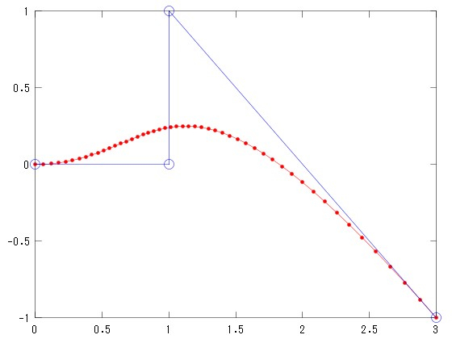
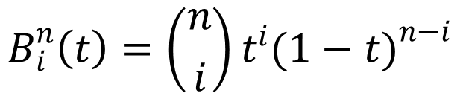

Polígono de control y base
$$B_{i}^{n}\left(t\right)=\left({n \atop i}\right)t^{i}{(1−t)}^{n−i}$$
$$\text{\{}B_{0}^{n}\left(t\right),…,B_{n}^{n}\left(t\right)\text{\}}$$

Slide 4
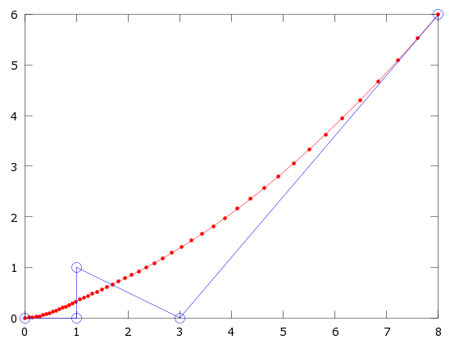
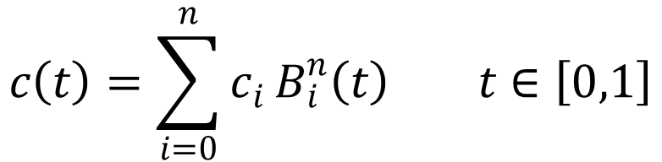
Expresión de la curva
$$c\left(t\right)=\sum_{i=0}^{n}{c_{i}}B_{i}^{n}\left(t\right) t∈\left[0,1\right]$$

Slide 5
Curva cuadrática
Curva cúbica
Curva de grado 4
Curva lineal

Slide 6
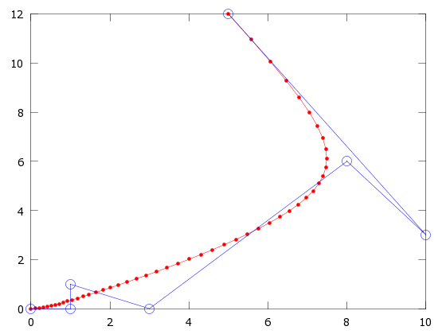
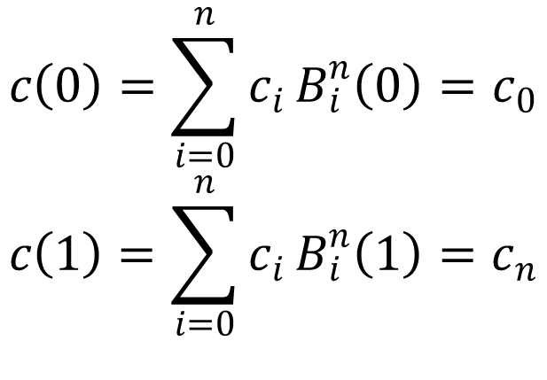
Propiedades
Interpolación en los extremos
$$c\left(0\right)=\sum_{i=0}^{n}{c_{i}}B_{i}^{n}\left(0\right)=c_{0}$$
$$c\left(1\right)=\sum_{i=0}^{n}{c_{i}}B_{i}^{n}\left(1\right)=c_{n}$$

Slide 7

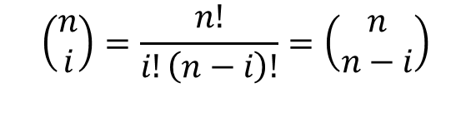

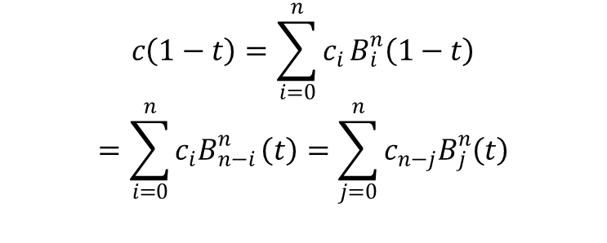
Propiedades
Simetría
$$\text{\{}\text{c}\text{0} \text{, }\text{… }\text{, }\text{cn}\text{\} \{}\text{cn}\text{ , }\text{cn}\text{−}\text{1 }\text{,} \text{… }\text{, }\text{c}\text{0}\text{\}}$$
$$c\left(1−t\right)=\sum_{i=0}^{n}{c_{i}}B_{i}^{n}\left(1−t\right)$$
$$=\sum_{i=0}^{n}{c_{i}B_{n−i}^{n}}\left(t\right)=\sum_{j=0}^{n}{c_{n−j}B_{j}^{n}\left(t\right)}$$
$$\left(\begin{aligned}n \\ i\end{aligned}\right)=\frac{n!}{i!\left(n−i\right)!}=\left(\begin{aligned}n \\ n−i\end{aligned}\right)$$
$$B_{i}^{n}\left(1−t\right)=B_{n−i}^{n}\left(t\right)$$

Slide 8

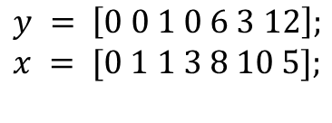
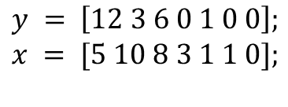
Propiedades
Simetría
$$y = \left[0 0 1 0 6 3 12\right];$$
$$x = [0 1 1 3 8 10 5];$$
$$y = \left[12 3 6 0 1 0 0\right];$$
$$x = [5 10 8 3 1 1 0];$$

Slide 9


Propiedades
Invarianza afín
$$t\left(u\right)=\frac{u−a}{b−a} u∈\left[a,b\right]$$
$c^{∗}\left(u\right)=c\left(t\left(u\right)\right)=c\left(\frac{u−a}{b−a}\right) u∈[$a,b]

Slide 10
Propiedades
Envolvente convexa

Slide 11
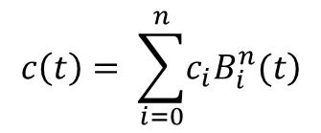


Propiedades
Disminución de la variación
$$c\left(t\right)= \sum_{i=0}^{n}{\left.c_{i}B_{i}^{n}(t\right)}$$
$$1=\left(1−t+t\right)$$
{$c_{0}^{1},…,c_{n+1}^{1}$}

Slide 12

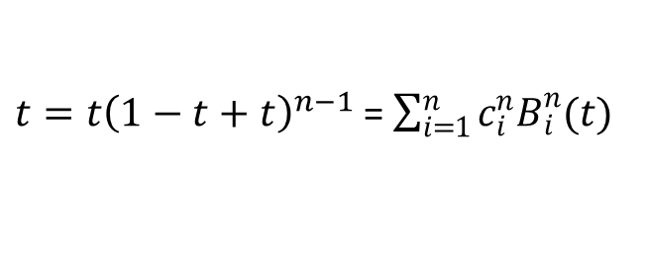
Propiedades
Precisión lineal
$t=t{\left(1−t+t\right)}^{n−1}$ =$\sum_{i=1}^{n}{c_{i}^{n}B_{i}^{n}(t)}$
$$c_{i}^{n}=\frac{i}{n}$$

Slide 13
Propiedades
Control pseudo-local

